Slide 1


Mastering MSBuild: Troubleshooting, Customization, and more
by Jan Krivanek & Yuliia Kovalova
Notes:
Jan & Yuliia introduction

Slide 2
Introduction to MSBuild
MSBuild.exe vs MSBuild.dll
Agenda
Troubleshooting
Advanced Customization

Slide 3
Introduction to MSBuild

Slide 4
What is MSBuild?
Declarative, data driven, XML based programming language
A battery of predefined scripts defining the build behaviour
Can be hard to troubleshoot
REPOSITORY:
dotnet/msbuild: The Microsoft Build Engine (MSBuild) is the build platform for .NET and Visual Studio.
Notes:
Jan

Slide 5
Key Characteristics
Extensible/flexible build process
Part of .NET SDK, Visual Studio ecosystem, and C# DevKit
Fundamental to .NET development
Notes:
Jan

Slide 6

MSBuild Components - VS and SDK Integration

Slide 7
Visual Studio Ecosystem Integration
MSBuild.exe Standard build tool for Visual Studio (~20 years old)
Integrated with Visual Studio Installer
Follows VS release lifecycle

Slide 8
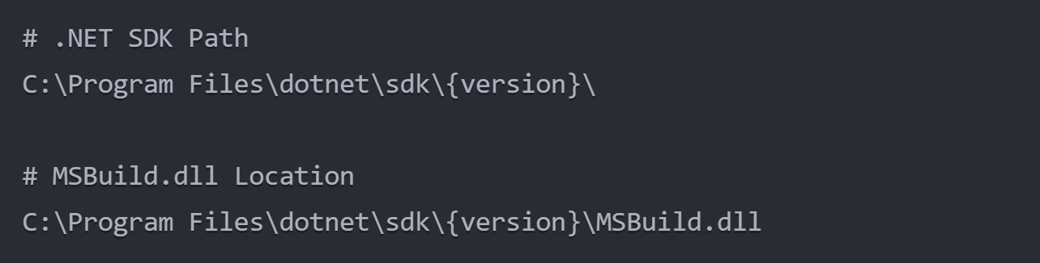
dotNET SDK
Contains MSBuild.dll
Executes it in dotnet CLI (dotnet build)
Why? - Cross platform capabilities!
.NET Release lifecycle

Slide 9
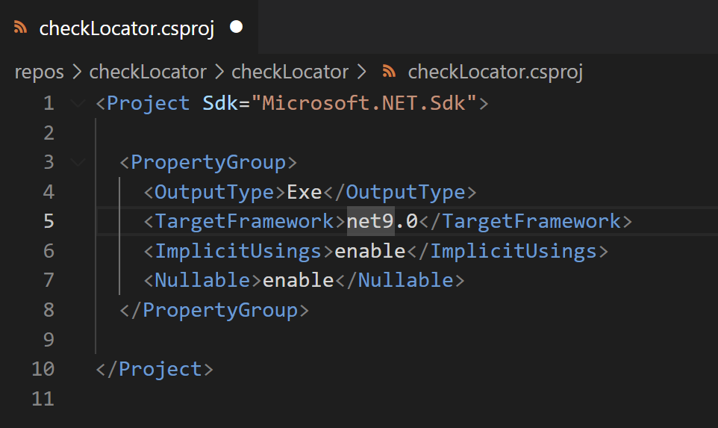
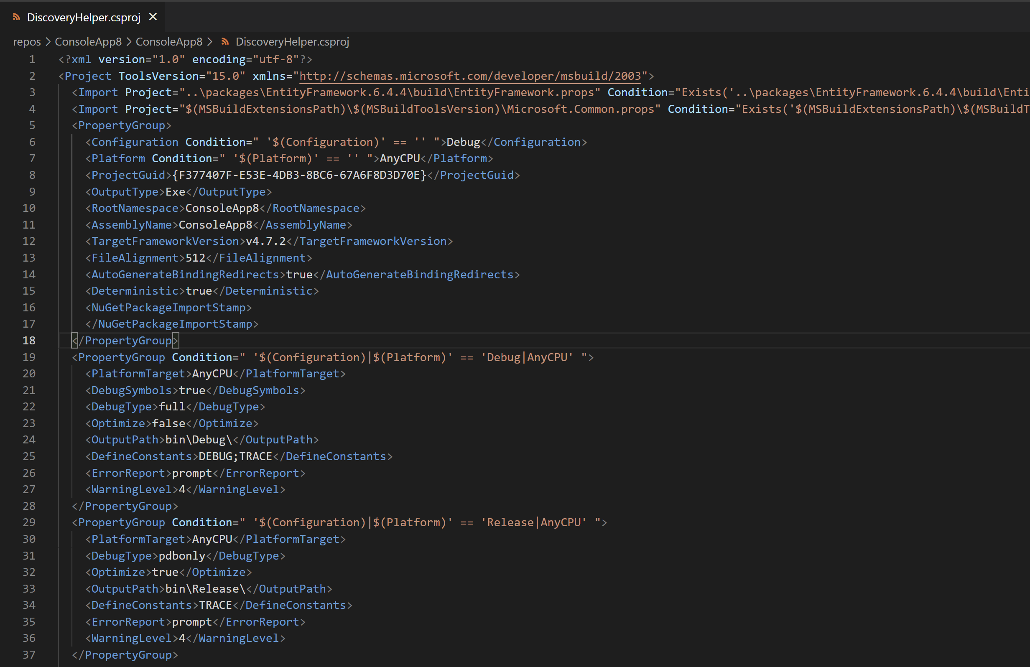
SDK vs Legacy Project Files
SDK
Legacy Project file (none-sdk)
Notes:
Jan (transition context)

Slide 10
Bright Future
Unification of SDK CLI and VS build. Steps:
Context – guaranteeing same env vars
Core Task host – ability to run core tasks from VS
(never :-)) VS core
Notes:
Task Host - Jan

Slide 11
MSBuild Depth
Notes:
Yuliia

Slide 12
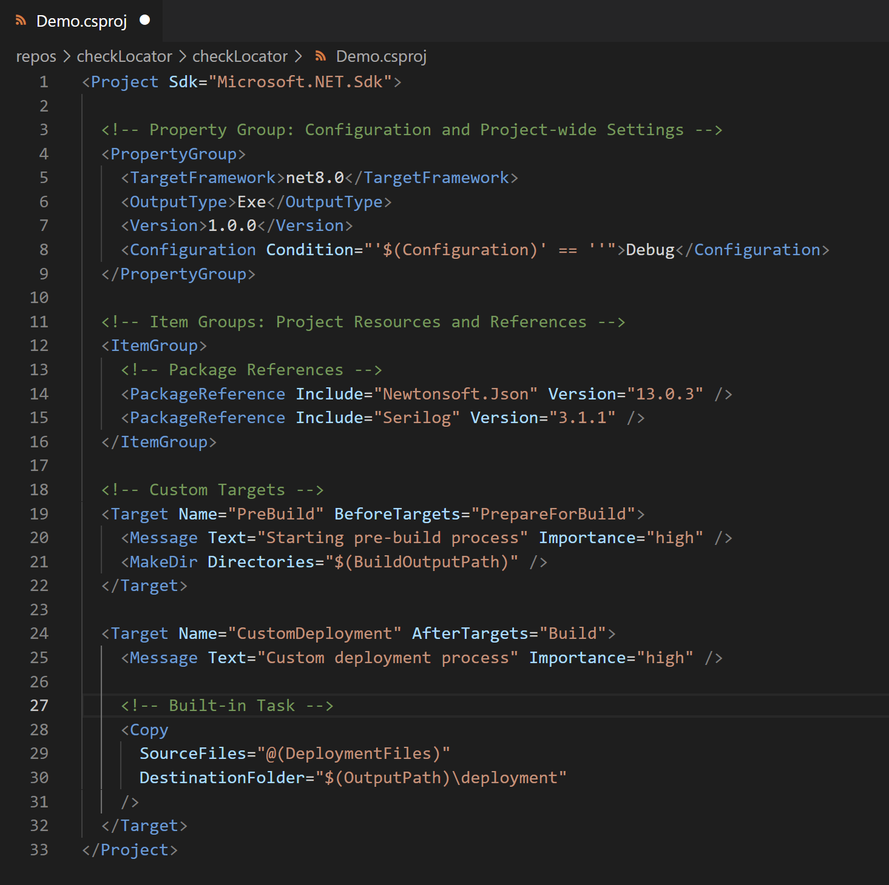
MSBuild Core Concepts
Project Files (e.g. .csproj, .fsproj)
Tasks
Targets
Items
Properties
Notes:
Yuliia

Slide 13
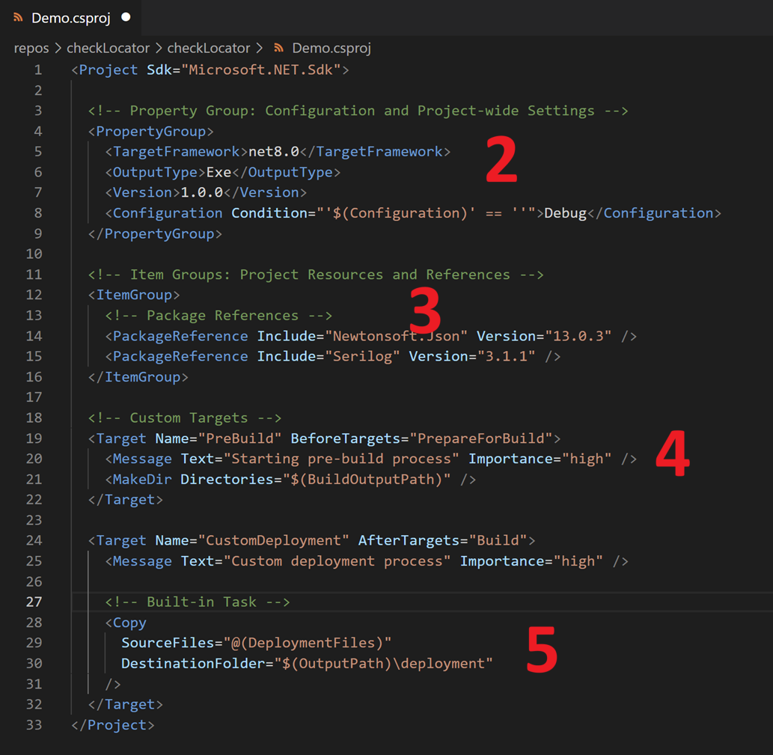
Build Workflow
1. Project Loading (Parsing xml)
2. Property Evaluation (Reading Property values)
3. Item Transformation (Pulling references)
4. Target Evaluation
5. Task Execution
6. Post-Build Processing
7. Logging and Reporting
Notes:
Yuliia: Logic of scripts -> evaluation = in-memory model; execution – call compiler

Slide 14

Notes:
Jan – jokes about Yuliia’s ways of investigation and transition to BinLog

Slide 15

MSBuild Binlog
/bl[:name.binlog]
$env:MSBUILDDEBUGENGINE = 1
msbuildlog.com (thank you Kirill Osenkov!)
Notes:
Jan

Slide 16
Demo: Structured BinLog Viewer
Notes:
Console app Yuliia &Jan

Slide 17
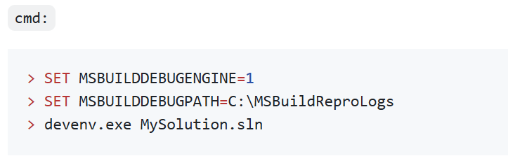
Collecting binlogs in VS

Slide 18
MSBuild relies on env variables
Build Waves and Feature Flags/Traits
Control build behavior
Enable/disable experimental features
Get extra information in logs
SdkAnalysisLevel (is getting more attention!)
ChangeWaves.md
MSBuild-Environment-Variables.md
Notes:
Jan

Slide 19
MSBuild Customization
Notes:
Jan can describe Directory.Build.props and Yuliia custom task

Slide 20
NuGet Packages
Directory.Build.props/targets (e.g. hidden.bomb.targets)
MSBuild Extensibility
.user, .rsp files
MSBuildExtensionsPath & MSBuildUserExtensionsPath
Notes:
Jan

Slide 21
Demo: MSBuild Extensibility
Notes:
Console app Yuliia &Jan 1. Directory.Build.targets
2. Custom task implementation and execution

Slide 22
Conclusions
MSBuild is powerful and flexible
Proper diagnostics are crucial (BinLog viewer is your friend)
Check documentation and repo issues
We always welcome contributions to our repo: https://github.com/dotnet/msbuild

Slide 23
Thank you

